Slide 1
Discrete Mathematics prime, composite, fundamental theorem of arithmetic, the well-ordering property, division algorithm, ideal
Liangfeng Zhang
School of Information Science and Technology
ShanghaiTech University

Slide 2
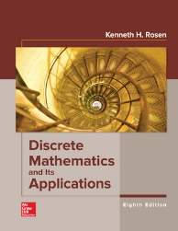

Course Information
Number theory: integers, …
Combinatorics: counting, designs,…
Logic: propositions, predicates, proofs,…
Graph theory: graphs, trees, set systems $⋯$
Discrete probability: discrete distributions $⋯$
Algebra: matrices, groups, rings and fields $⋯$
Theoretical computer science: algorithms $⋯$
Information theory: codes $⋯$
$⋯$
(4)
(2,6,8)
(1)
(10,11)
Textbook: Discrete Mathematics and Its Applications (8th edition)
Kenneth H. Rosen, William C Brown Pub, 2018.

Slide 3
Course Information
Course Materials: Lecture slides, homework questions, …
Piazza: https://piazza.com/class/kzjye4h1zeq4i3
Blackboard: https://egate.shanghaitech.edu.cn/new/index.html
HW Submission: submit a soft copy (pdf/jpg) of HW solutions
Gradescope: https://www.gradescope.com/courses/370554
Q&A: online Q&A, office hours, and tutorial sessions
Online Q&As: post your questions to Piazza and get answers
Instructor’s Office hours: 20:00-21:00, Wednesday, SIST 2-202.i
TAs’ Tutorial Sessions: 19:50-21:30, Monday & Thursday
Evaluation:
Attendance: 10% (random codes)
Homework: 30% (no plagiarisms, firm deadline, …)
Midterm: 30% (on the first half of the course)
Final Exam: 30% (on the second half of the course)

Slide 4
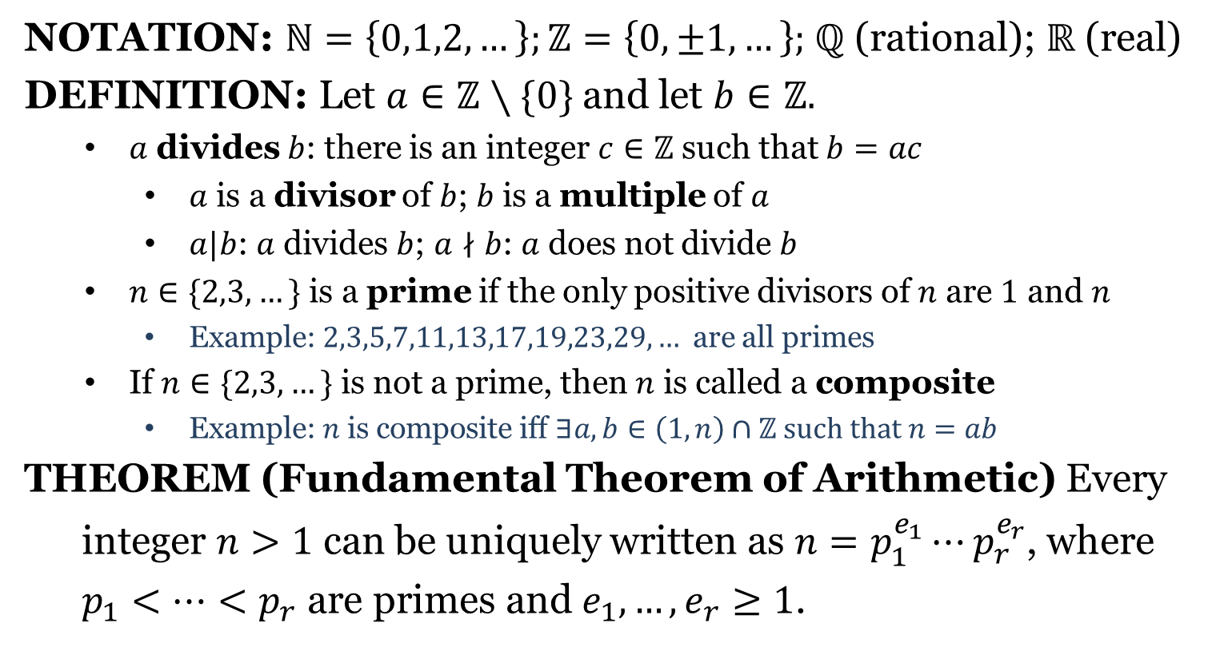
Divisibility
NOTATION: $ℕ=\left\{0,1,2,…\right\};ℤ=\left\{0,±1,…\right\};$ $ℚ$ (rational); $ℝ$ (real)
DEFINITION: Let $a∈ℤ∖\{0\}$ and let $b∈ℤ.$
$a$ divides $b$: there is an integer $c∈ℤ$ such that $b=ac$
$a$ is a divisor of $b$; $b$ is a multiple of $a$
$a|b$: $a$ divides $b$; $a∤b$: $a$ does not divide $b$
$n∈\{2,3,…\}$ is a prime if the only positive divisors of $n$ are $1$ and $n$
Example: $2,3,5,7,11,13,17,19,23,29,…$ are all primes
If $n∈\{2,3,…\}$ is not a prime, then $n$ is called a composite
Example: $n$ is composite iff $∃a,b∈\left(1,n\right)∩ℤ such that n=ab$
THEOREM (Fundamental Theorem of Arithmetic) Every
integer $n>1$ can be uniquely written as $n=p_{1}^{e_{1}}⋯p_{r}^{e_{r}}$, where
$p_{1}<…<p_{r}$ are primes and $e_{1}, …,e_{r}≥1$.

Slide 5
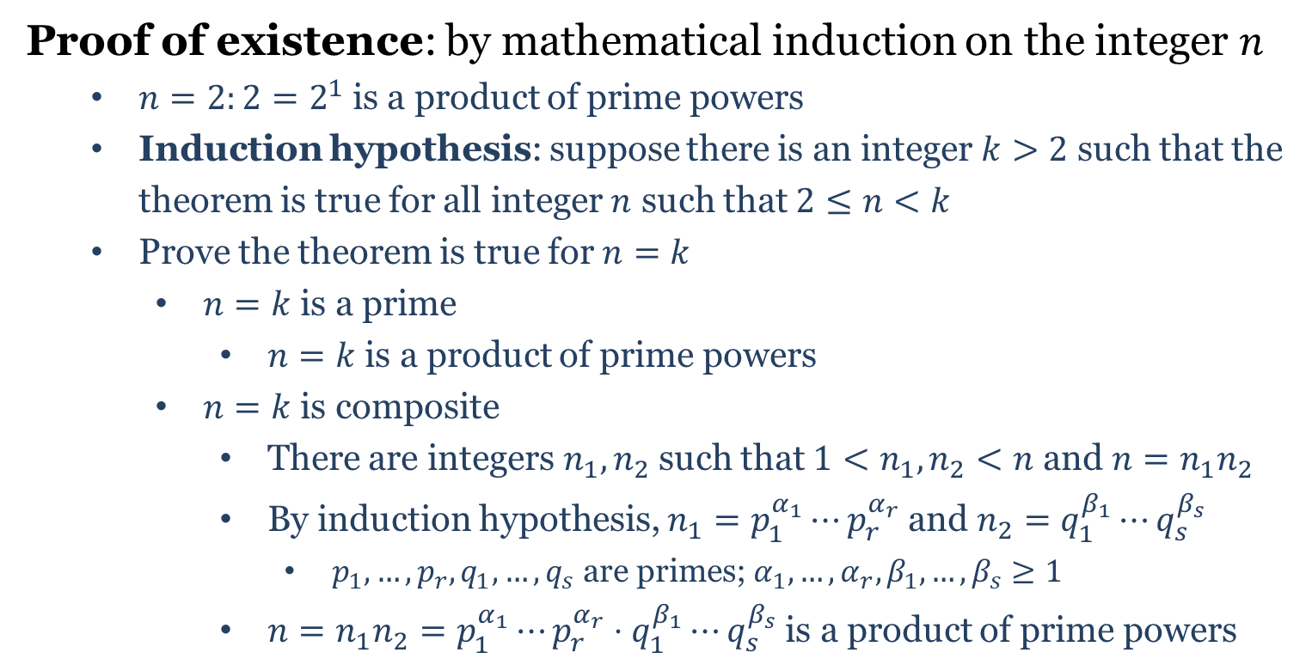
FTA Proof
Proof of existence: by mathematical induction on the integer $n$
$n=2:2=2^{1}$is a product of prime powers
Induction hypothesis: suppose there is an integer $k>2$ such that the theorem is true for all integer $n$ such that $2≤n<k$
Prove the theorem is true for $n=k$
$n=k$ is a prime
$n=k$ is a product of prime powers
$n=k$ is composite
There are integers $n_{1},n_{2}$ such that $1<n_{1},n_{2}<n$ and $n=n_{1}n_{2}$
By induction hypothesis, $n_{1}=p_{1}^{α_{1}}⋯p_{r}^{α_{r}}$ and $n_{2}=q_{1}^{β_{1}}⋯q_{s}^{β_{s}}$
$p_{1},…,p_{r},q_{1},…,q_{s}$ are primes; $α_{1},…,α_{r},β_{1},…,β_{s}≥1$
$n=n_{1}n_{2}=p_{1}^{α_{1}}⋯p_{r}^{α_{r}}⋅q_{1}^{β_{1}}⋯q_{s}^{β_{s}}$ is a product of prime powers

Slide 6
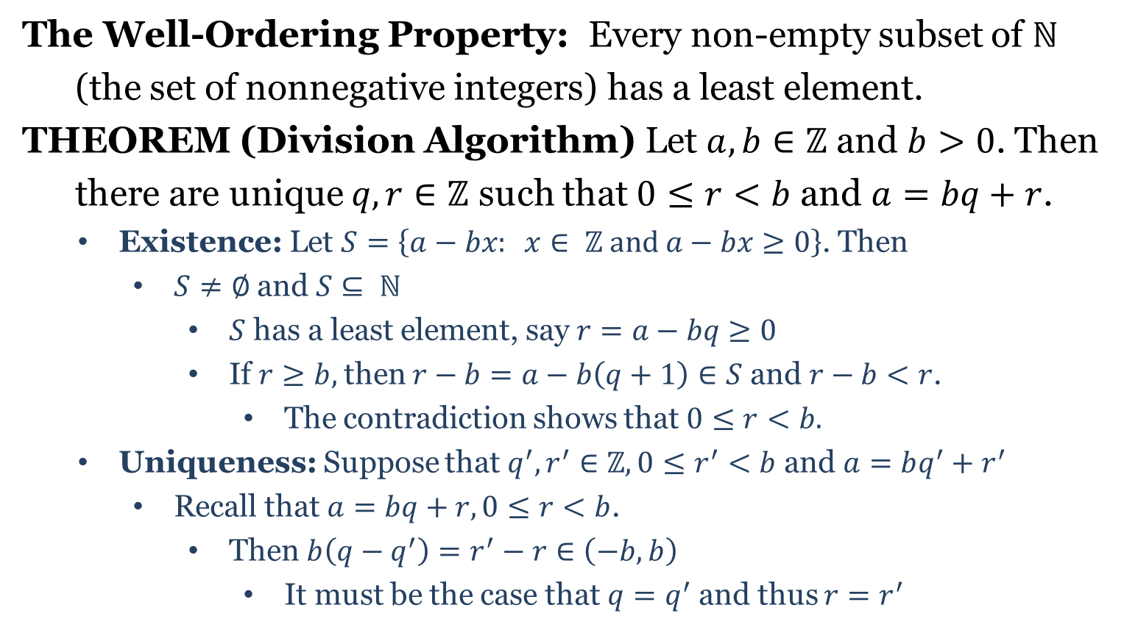
Division Algorithm
The Well-Ordering Property: Every non-empty subset of $ℕ$
(the set of nonnegative integers) has a least element.
THEOREM (Division Algorithm) Let $a,b∈ℤ$ and $b>0$. Then
there are unique $q,r∈ℤ$ such that $0≤r<b$ and $a=bq+r$.
Existence: Let $S=\left\{a−bx: x∈ ℤ and a−bx≥0\right\}$. Then
$S≠∅$ and $S⊆ ℕ$
$S$ has a least element, say $r=a−bq≥0$
If $r≥b,$then $r−b=a−b\left(q+1\right)∈S$ and $r−b<r$.
The contradiction shows that $0≤r<b.$
Uniqueness: Suppose that $q^{′}, r^{′}∈ℤ, 0≤r^{′}<b$ and $a=bq^{′}+r^{′}$
Recall that $a=bq+r, 0≤r<b$.
Then $b\left(q−q^{′}\right)=r^{′}−r∈\left(−b,b\right)$
It must be the case that $q=q^{′}$ and thus $r=r^{′}$

Slide 7
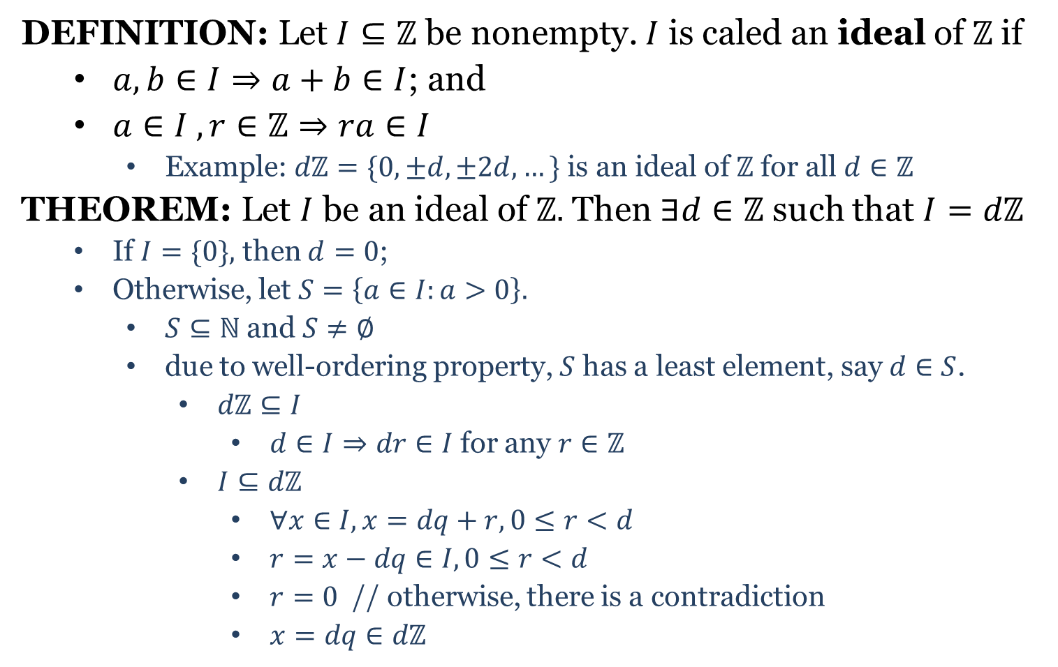
Ideal
DEFINITION: Let $I⊆ℤ$ be nonempty. $I$ is caled an ideal of $ℤ$if
$a,b∈I⇒a+b∈I$; and
$a∈I , r∈ℤ⇒ra∈I$
Example: $dℤ=\{0,±d,±2d,…\}$ is an ideal of $ℤ$ for all $d∈ℤ$
THEOREM: Let $I$ be an ideal of $ℤ.$ Then $∃d∈ℤ$ such that $I=dℤ$
If $I=\{0\},$ then $d=0$;
Otherwise, let $S=\left\{a∈I:a>0\right\}.$
$S⊆ℕ$ and $S≠∅$
due to well-ordering property, $S$ has a least element, say $d∈S$.
$dℤ⊆I$
$d∈I⇒dr∈I$ for any $r∈ℤ$
$I⊆dℤ$
$∀x∈I, x=dq+r, 0≤r<d$
$r=x−dq∈I, 0≤r<d$
$r=0$ // otherwise, there is a contradiction
$x=dq∈dℤ$

Slide 8
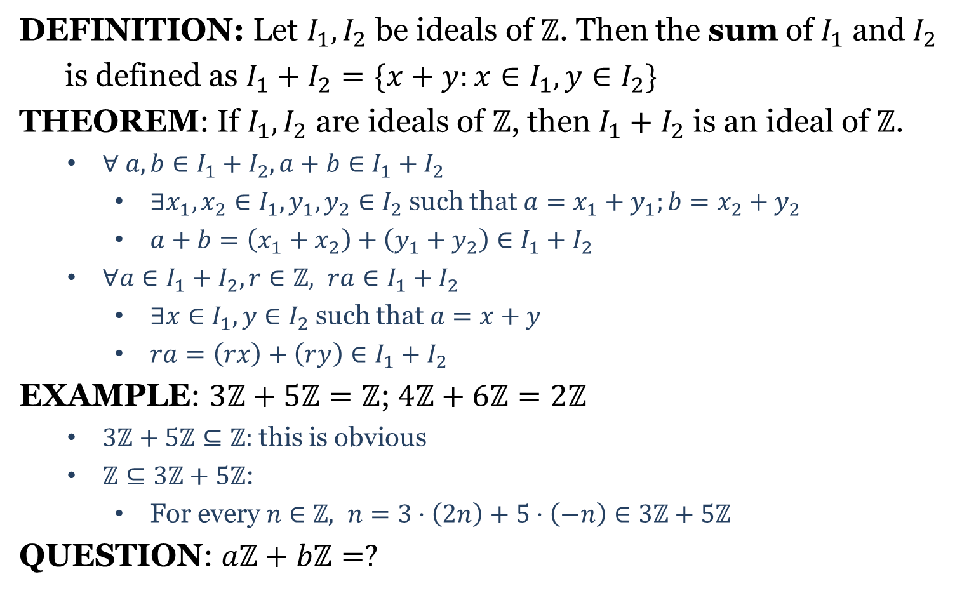
Ideal
DEFINITION: Let $I_{1}, I_{2}$ be ideals of $ℤ$. Then the sum of $I_{1}$ and $I_{2}$
is defined as $I_{1}+I_{2}=\{x+y:x∈I_{1},y∈I_{2}\}$
THEOREM: If $I_{1},I_{2}$ are ideals of $ℤ$, then $I_{1}+I_{2}$ is an ideal of $ℤ$.
$∀ a,b∈I_{1}+I_{2}, a+b∈I_{1}+I_{2}$
$∃x_{1},x_{2}∈I_{1}, y_{1},y_{2}∈I_{2}$ such that $a=x_{1}+y_{1};b=x_{2}+y_{2}$
$a+b=\left(x_{1}+x_{2}\right)+\left(y_{1}+y_{2}\right)∈I_{1}+I_{2}$
$∀a∈I_{1}+I_{2}, r∈ℤ, ra∈I_{1}+I_{2}$
$∃x∈I_{1},y∈I_{2}$ such that $a=x+y$
$ra=\left(rx\right)+\left(ry\right)∈I_{1}+I_{2}$
EXAMPLE: $3ℤ+5ℤ=ℤ$; $4ℤ+6ℤ=2ℤ$
$3ℤ+5ℤ⊆ℤ:$ this is obvious
$ℤ⊆3ℤ+5ℤ$:
For every $n∈ℤ, n=3⋅\left(2n\right)+5⋅\left(−n\right)∈3ℤ+5ℤ$
QUESTION: $aℤ+bℤ=?$

